Slide 1
OCS Stewardship
CORE SCIENCE STORY
This document has been sponsored and developed by AstraZeneca. The content is intended for healthcare professionals only.

Slide 2



Contents
Part 1
Current patterns of OCS use
Part 2
The impact and burden of OCS and use in asthma
Part 3
Practical solutions
for implementing
OCS stewardship

Slide 3
Part 1 – Current patterns of OCS use

Slide 4

Part 1 – Learning objectives
Define the aims of OCS stewardship in asthma care and explain its rationale
Identify the guideline-defined place of OCS in the treatment of asthma
Describe the common patterns of OCS use in asthma
By the end of this slide deck, you will be able to:
1
2
3

Slide 5

Overuse of OCS in severe asthma is commonplace globally
In a prescription database study, 7.2% of patients with asthma were frequent OCS users¹
In RWE studies, 15–25% of patients with severe asthma received long-term* or frequent acute courses of OCS^{2–7}
In RWE studies, 12–64% of patients with severe asthma received long-term* or frequent acute courses of OCS^{4,8–12}

Slide 6

Calls to action urge a structured, collaborative approach to OCS stewardship^{1,2}
SCS use comes with costly and burdensome AEs; given the range of treatment options now available, HCPs need to carefully evaluate the benefits of SCS against the potential harms and adopt SCS-sparing and stewardship strategies
Use only when clinically appropriate
OCS and SCS
stewardship^{1–5}
Use lowest dose possible; taper as soon as possible
Monitor use and AEs closely
Educate patients and physicians on risks
Identify and manage AI when using SCS
A structured and collaborative SCS stewardship approach is urgently required to protect patients from the potential harm of SCS use²

Slide 7

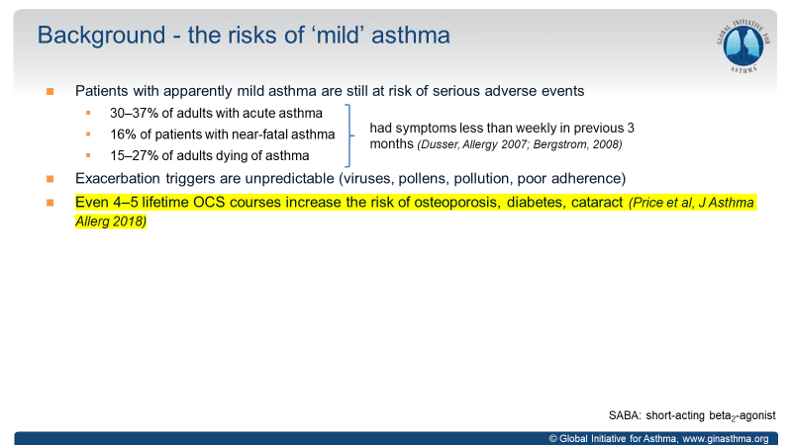
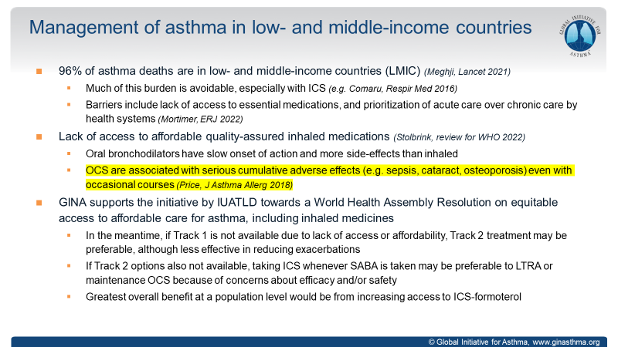
GINA 2024 guidance advises that maintenance OCS should be considered only as a last resort
GINA 2024 acknowledges the serious cumulative AEs of OCS use¹
Even 4–5 lifetime OCS courses increase the risk of osteoporosis, diabetes and cataract
OCS are associated with serious cumulative AEs
(e.g., sepsis, cataract, osteoporosis) even with occasional courses
  These statements are cited in the study conducted by
  Price DB et al (2018), in which a significant increase in the risk of AEs with both cumulative SCS exposure and daily exposure was demonstrated, even at the lowest exposure categories²

Slide 8

Recommended use of short-term OCS is restricted to severe acute asthma exacerbations¹
 | Corticosteroids |  | Placebo |  |  | Odds ratio | Odds ratio
Study or subgroup | Events (n) | Total (n) | Events (n) | Total (n) | Weight | M-H, random (95% CI) | M-H, random (95% CI)
Connett 1994a | 13 | 19 | 15 | 18 | 6.0% | 0.43 (0.09, 2.09)
Connett 1994b | 7 | 18 | 12 | 15 | 6.0% | 0.16 (0.03, 0.77)
Lin 1997 | 7 | 23 | 5 | 22 | 7.4% | 1.49 (0.39, 5.65)
Lin 1999 | 8 | 30 | 11 | 26 | 9.0% | 0.50 (0.16, 1.52)
Littenberg 1986 | 9 | 48 | 23 | 49 | 10.8% | 0.26 (0.10, 0.65)
Rodrigo 1994 | 4 | 49 | 5 | 49 | 7.1% | 0.78 (0.20, 3.11)
Scarfone 1993 | 11 | 36 | 19 | 39 | 10.5% | 0.46 (0.18, 1.19)
Schneider 1988 | 5 | 27 | 12 | 27 | 8.1% | 0.28 (0.08, 0.97)
Stein 1990 | 21 | 44 | 23 | 47 | 11.7% | 0.95 (0.42, 2.17)
Storr 1987 | 53 | 73 | 65 | 67 | 6.4% | 0.08 (0.02, 0.36)
Tal 1990 | 4 | 17 | 4 | 13 | 5.8% | 0.69 (0.14, 3.52)
Wolfson 1994 | 17 | 42 | 15 | 46 | 11.2% | 1.41 (0.59, 3.36)
Total (95% CI) |  | 426 |  | 418 | 100% | 0.50 (0.31, 0.81)
Total events | 159 |  | 209
Heterogeneity: Tau²= 0.32; Chi²=21.27; df=11 (P=0.03); I²=48%
Test for overall effect: Z=2.86 (P=0.004)
GINA 2024 recommends a
short course, usually 5–7 days,
of OCS for adult patients with a
severe acute exacerbations¹
0.01
0.1
1
10
100
CS therapy
Placebo
Adapted from Rowe BH, et al. 2001²

Slide 9
SCS prescriptions for asthma contribute a significant proportion of the total prescribed SCS in seven key conditions
Relative contribution to the total prescribed SCS dose¹*
Asthma
Crohn’s disease
COPD
Nasal polyps
Rheumatoid arthritis
SLE
Ulcerative colitis
Other
Adapted from Menzies-Gow AN, et al. 2024

Slide 10
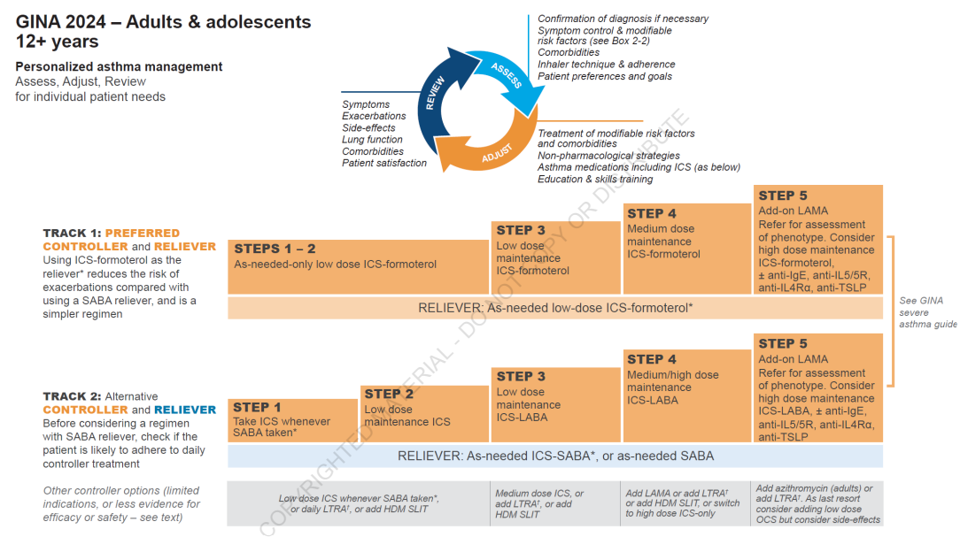
OCS as add-on treatment should be restricted to GINA
Step 5 and only as an alternative to other preferred options

Slide 11
Summary
OCS stewardship is a collaborative, systematic effort to protect patients with asthma from potential overexposure to OCS and thereby improve care¹
Guidelines recommend minimising OCS use and restricting treatment to acute courses for severe acute asthma exacerbations²
OCS as add-on treatment should be restricted to GINA Step 5 and only as a last resort after other preferred options²
Despite this, long-term or frequent short-term use of OCS is common; patients with mild/moderate asthma may also be high-OCS users³

Slide 12
Part 2 – The impact and burden of OCS use in asthma
12

Slide 13
Part 2 – Learning objectives
Understand the clinical burden associated with OCS overuse in terms of acute and
chronic complications and HRQoL
Understand the economic burden associated with OCS use in terms of HCRU
and costs
Explain the importance of OCS stewardship for optimising asthma care and how it has been achieved in rheumatoid arthritis
By the end of this slide deck, you will be able to:
1
2
3

Slide 14
Potential corticosteroid-induced morbidities have been identiﬁed in 93% of patients with severe asthma¹
01 Clinical burden
ORs of OCS-related morbidity (severe vs mild/moderate asthma; N=4783)¹
RWE from OPCRD
Psychiatric disorders
OR: 1.43; P<0.001 (38% vs 31%)
Hypertension
OR: 1.35; P=0.001 (34% vs 29%)
CVD
OR: 1.36; P=0.035 (10% vs 7%)
Cataract
OR: 1.89; P<0.001 (9% vs 5%)
Dyspeptic disorders
OR: 3.99; P<0.001 (65% vs 34%)
Metabolic disorders:
Type 2 diabetes mellitus
OR: 1.46; P=0.006 (10% vs 7%)
BMI >30 kg/m²
OR: 1.36; P<0.001 (42% vs 35%)
Osteoporosis
OR: 5.23; P<0.001 (16% vs 4%)

Slide 15
OCS stewardship is needed to prevent AEs associated with intermittent OCS use
01 Clinical burden
Hazard ratios* of OCS-related AEs for patients receiving intermittent OCS versus OCS-naïve patients^{1†}
Dyslipidaemia (n=401,314)
Behavioural issues‡ (n=113,393)
Renal disease (n=437,297)
Osteoporosis (n=447,598)
Hypertension (n=418,362)
Peptic ulcer (n=469,345)
CVD (n=460,277)
Depression/anxiety (n=359,678)
Sleep disorders (n=440,024)
Cataract (n=463,805)
Glaucoma (n=460,600)
Type 2 diabetes mellitus (n=455,035)
Pneumonia (n=476,167)
Sleep apnoea (n=473,910)
One-off OCS
Less frequent OCS§
Frequent OCS¶
0
1
2
3
4
Hazard ratio (95% CI)
Adapted from Heatley H, et al. 2023

Slide 16
SCS use is associated with a high risk of serious AEs¹
01 Clinical burden
Adjusted
Unadjusted
SCS vs non-SCS
Hazard ratio
(95% CI)
Osteoporosis diagnosis/fracture (N=42502, events = 209)
3.11 (1.87, 5.19)
Pneumonia (N=48130, events = 1599)
2.68 (2.30, 3.11)
Osteoporosis diagnosis (N=46844, events = 1346)
1.96 (1.63, 2.34)
Heart failure (N=47140, events = 1207)
1.63 (1.32, 2.00)
Cardio-cerebrovascular disease (N=44224, events = 2600)
1.53 (1.36, 1.72)
Cataract (N=45296, events = 2566)
1.50 (1.31, 1.73)
Myocardial infarction (N=46502, events = 944)
1.41 (1.15, 1.73)
Sleep apnoea (N=47960, events = 289)
1.40 (1.04, 1.86)
Renal impairment (N=40274, events = 4973)
1.36 (1.26, 1.47)
Depression/anxiety (N=15922, events = 2811)
1.31 (1.21, 1.41)
Cerebrovascular accident (N=46456, events = 1274)
1.30 (1.10, 1.55)
Peptic ulcer (N=46298, events = 354)
1.28 (0.94, 1.74)
Type 2 diabetes mellitus (N=43616, events = 2946)
1.26 (1.15, 1.37)
Glaucoma (N=46848, events = 706)
1.23 (0.99, 1.53)
BMI increase (N=25788, events = 14395)
1.14 (1.10, 1.18)
Hypertension (N=24496, events = 2612)
1.06 (0.97, 1.16)
Dyslipidaemia (N=33806, events = 5869)
1.03 (0.97, 1.09)
Adapted from Price DB, et al. 2018
0.9
1
1.5
2
2.5
3
3.5
4
5

Slide 17
Even two lifetime short courses of SCS are associated with serious AEs¹
01 Clinical burden
Adverse outcomes in the SCS arm
vs >0- to <0.5-g reference arm¹
Multivariate adjusted OR for developing a chronic complication from SCS vs no SCS use^{2**}
Cumulative SCS exposure (1 g)*
Outcome |  |  |  | Adjusted hazard ratio (95% CI)
Type 2 diabetes mellitus (N=21,808) |  |  |  | 1.027 (1.021, 1.033)
Myocardial infarction (N=23,251) |  |  |  | 1.026 (1.018, 1.033)
Heart failure (N=23,570) |  |  |  | 1.029 (1.021, 1.036)
Osteoporosis diagnosis and fracture (N=21,251) |  |  |  | 1.033 (1.022, 1.043)
Cataract (N=22,648) |  |  |  | 1.028 (1.022, 1.034)
Renal impairment (N=20,137) |  |  |  | 1.020 (1.015, 1.026)
Outcome |  |  |  | Adjusted hazard ratio (95% CI)
Obesity |  |  |  | 1.70 (1.52, 1.89)
 |  |  |  | 1.35 (1.27, 1.44)
Hypertension |  |  |  | 1.32 (1.22, 1.42)
 |  |  |  | 1.12 (1.08, 1.17)
Diabetes |  |  |  | 1.34 (1.17, 1.53)
 |  |  |  | 1.13 (1.04, 1.22)
Any chronic complication |  |  |  | 1.26 (1.18, 1.35)
 |  |  |  | 1.06 (1.02, 1.10)
1–3 SCS users
4+ SCS users
Adapted from Price DB, et al. 2018
Adapted from Zeiger R, et al. 2020

Slide 18
SCS use is associated with a positive dose-response relationship with risk of death among patients with asthma¹
01 Clinical burden
Association of cumulative SCS dose and average SCS daily exposure with risk of death among patients with asthma¹
(N=9,413 matched pairs)
Cumulative dose, ≥10 g (n=633)
Cumulative dose, 5–<10 g (n=693)
Cumulative dose, 2.5–<5 g (n=1140)
Cumulative dose, 1.0–<2.5 g (n=2592)
Cumulative dose, 0.5–<1.0 g (n=2534)
Cumulative dose, >0–<0.5 g (n=1821)
Average daily exposure ≥7.5 mg/day (n=148)
Average daily exposure 5–<7.5 mg/day (n=166)
Average daily exposure 2.5–<5 mg/day (n=431)
Average daily exposure 0.5–<2.5 mg/day (n=3426)
Average daily exposure >0–<0.5 mg/day (n=5242)
Adjusted
Unadjusted
Hazard ratio
(95% CI)
2.17 (1.78, 2.64)
1.56 (1.28, 1.90)
1.30 (1.09, 1.56)
1.11 (0.93, 1.31)
0.95 (0.79, 1.12)
Reference
4.56 (3.45, 6.04)
2.72 (2.16, 3.42)
2.50 (2.11, 2.97)
1.52 (1.37, 1.69)
Reference
0.9
1
1.5
2
3
4
5
6
7
Hazard ratio

Slide 19

Use of high-dose corticosteroids is associated with an increased risk of mortality^{1–4}
01 Clinical burden
Regular OCS use was associated with an increased incidence of
all-cause mortality compared with
non-OCS use¹
Mortality rates of OCS users increased compared with non-users, and mortality rates increased with increasing
OCS exposure²
The risk of mortality in patients exposed to ≥10-g cumulative dose of SCS was more than twice that for patients exposed to a <0.5-g cumulative dose³
Patients with asthma receiving high-dose corticosteroids had a higher hazard ratio of mortality than patients treated with
low-dose corticosteroids⁴

Slide 20
Corticosteroid use is associated with higher HCRU and related costs associated with each patient¹
02 Economic burden
RWE analysis of patients with asthma exposed to treatment with
corticosteroids, and those who were not¹
Asthma-related HCRU costs*
All-cause adverse-outcome associated costs*
Total cost
= £402.93
Total cost
= £1483.03
 | Medication costs
 | Hospitalisation
Total cost
= £1164.83
 | A&E department visits
 | Specialist visit
 | GP visit
226.72
Mean annual asthma-related HCRU costs (2016 £)†
Mean annual all-cause adverse outcome-associated HCRU costs (2016)†
Total cost
= £166.39
28.15
46.86
1.36
106.08
2.99
36.64
0.22
48.16
10.27
95.24
n: 9,413
n: 9,413
n: 9,413
n: 9,413
Adapted from Voorham J, et al. 2019

Slide 21
OCS-associated HCRU is dose dependent
02 Economic burden
Incidence rate ratio of HCRU for all SCS-related AEs by average daily SCS exposure¹
Adjusted
Unadjusted
≥7.5 mg/day
5.0–<7.5 mg/day
2.0–<5.0 mg/day
0.5–<2.5 mg/day
Reference
Primary care prescriptions
≥7.5 mg/day
5.0–<7.5 mg/day
2.0–<5.0 mg/day
0.5–<2.5 mg/day
Reference
Emergency department attendances
≥7.5 mg/day
5.0–<7.5 mg/day
2.0–<5.0 mg/day
0.5–<2.5 mg/day
Reference
Hospitalisations
≥7.5 mg/day
5.0–<7.5 mg/day
2.0–<5.0 mg/day
0.5–<2.5 mg/day
Reference
Specialist consultations
≥7.5 mg/day
5.0–<7.5 mg/day
2.0–<5.0 mg/day
0.5–<2.5 mg/day
Reference
GP consultations
0.9
1.0
1.5
2.0
2.5
3.0
3.5
4.0
Incidence rate ratio

Slide 22
Annual costs of OCS-related AEs increase with asthma severity
02 Economic burden
Annual OCS-related AE costs at a population level¹
Population comparisons of annual OCS-related AE costs¹
€110,600,000
€242,705,721
n=3,220
n=808
€167,501,815
€75,200,000
Costs (2017 €)*
n=3,975
Costs (2017 €)*
n=4,783
€132,080,084
n=2,412
€35,400,000
n=6,387
Non-asthma control
Moderate asthma
Severe asthma
Severe asthma
vs control†
Severe asthma vs moderate†
Moderate asthma
vs control†
Adapted from Canonica, et al. 2019

Slide 23

Use of SCS is associated with reduced HRQoL
02 Economic burden
HRQoL with SCS,* compared with no SCS, by number of annual prescriptions¹
†
−0.010
The true burden of OCS on HRQoL is not well understood in policy and practice because it is not assessed in outcome studies²
−0.030
Coefficient
−0.050
−0.070
−0.090
Adapted from Sullivan PW, et al. 2017

Slide 24



Patients with severe asthma can struggle with the psychological effects of OCS
03 Stewardship
You just keep thinking I’m not going to sleep because I've got this drug¹
I suffered [from] severe depression. At my lowest, [I] never ever, ever thought I’d feel the way I did¹
I’m embarrassed [about the weight gain] because I can see that I’m so puffy³
I nearly drove a car
off the side of the hill
one time because of it …
I don’t think very straight when I’m on it¹
I’ve been more irritable since I’ve been
on steroids²
I was starting to feel really angry, and that’s not me¹

Slide 25




Published Charters define the principles of care that should be expected by people with severe asthma
03 Stewardship
Patient charter: six principles for the care of people with severe asthma¹
I deserve a timely, comprehensive assessment of my asthma and its severity
I deserve a timely, straightforward referral to an appropriate specialist for my asthma when it is not
well controlled
I deserve to understand what makes my
asthma worse
I deserve access to treatment and care that reduces the impact of asthma on my daily life
I deserve not to be
reliant on SCS
I deserve to be involved in decisions about my treatment and care
OCS Charter: recommendations to change the role of OCS in the management of severe asthma²
Outlines specific OCS-sparing strategies, such as defining threshold doses, using alerts to trigger specialist referrals and raising awareness of the health and cost implications associated with OCS use

Slide 26
The use of OCS in rheumatoid arthritis has undergone major reform over the last 20 years – driven by guideline changes
03 Stewardship
INCREASING UNDERSTANDING OF DISEASE PATHOGENESIS
1998 (USA) / 2000 (EU)
First biologic approved for the treatment of rheumatoid arthritis^{1,2}
2007
EULAR task force acknowledged the need for
evidence-based recommendations on management of SCS therapy in
rheumatic diseases³
2010+
Current guidelines recommend corticosteroids only as ‘bridging’ therapy to be tapered as rapidly as clinically feasible^{4,5}
2000
2005
2010
2015
present
The hazard ratio of ceasing OCS has increased over time⁶
Average probability of OCS use over time in patients with rheumatoid arthritis⁶
2001–2005
0.55
2005–2008
0.47
2008–2012
0.42
2012–2015
0.39
1.00
1.60
2.38
3.56

Slide 27

A call to action: together, let’s relegate OCS use to last resort
03 Stewardship
There is a need to protect patients from potential overexposure to OCS¹
Inappropriate OCS use is associated with serious
AEs and increased healthcare costs^{2–4}
SABA overuse is an indicator of poor asthma control, leaving
patients at risk of exacerbation and exposure to OCS^{5,6}

Slide 28
Summary
SCS/OCS use is associated with significant clinical burden in terms of acute (e.g., gastrointestinal) and chronic complications (e.g., metabolic)¹
Risks from SCS use occur after as little as two lifetime short courses²
SCS overuse is associated with a significant reduction in QoL vs no SCS use, as well as significant HCRU and monetary costs^{3–5}
Effective OCS stewardship has been achieved in rheumatoid arthritis and is a realistic target in asthma^{6–8}

Slide 29
References
Asthma and Allergy Foundation of America (AAFA). Oral corticosteroid stewardship statement. 2018. Available from: https://aafa.org/wp-content/uploads/2022/08/oral-corticosteroid-stewardship-statement-november-2018.pdf (Accessed May 2024).
Black RJ, et al. Arthritis Res Ther. 2017;19:253.
Bleecker ER, et al. Ann Allergy Asthma Immunol. 2022;128:78–88.
Broder MS, et al. Ann Allergy Asthma Immunol. 2017;118:638–639.
Busse WW, et al. J Asthma. 2022;59:1051–1062 (Supplementary material).
Canonica GW, et al. World Allergy Organ. J 2019;12:100007.
Clark VL, et al. J Asthma Allergy. 2021;14:245–258.
Domingo Ribas C, et al. Eur Respir J. 2020;56(Suppl. 64):4639 (Abstract).
Ekström M, et al. Allergy. 2019;74:2181–2190.
European Medicines Agency (EMA). Enbrel® (etanercept) summary of product characteristics. Available from: http://www.ema.europa.eu/docs/en_GB/document_library/EPAR_-_Product_Information/human/000262/WC500027361.pdf (Accessed May 2024).
Foster JM, et al. Eur Respir J. 2017;50:1700765.
GINA Italy. Severe asthma 2021. Available from: https://ginasma.it/wp-content/uploads/materiali/adattamento/asma_grave_2021.pptx (Accessed May 2024). Phipatanakul W, et al. Am J Resp Crit Care Med. 2017;195:1439–1448.
Global Initiative for Asthma (GINA). Global strategy for asthma management and prevention. 2024. Available from: https://ginasthma.org/wp-content/uploads/2024/05/GINA-2024-Main-Report-WMS-1.pdf (Accessed May 2024).
Global Initiative for Asthma (GINA). What’s new in GINA 2022? Available from: https://ginasthma.org/wp-content/uploads/2022/05/GINA-2022-Whats-New-Slides.pptx
(Accessed May 2024)
Haughney J, et al. Adv Ther 2023;40:2577–2594.
Heatley H, et al. Thorax. 2023 Sep;78(9):860-867.
Heffler E, et al. J Allergy Clin Immunol Pract. 2019;7:1462–1468.
Hoes JN, et al. Ann Rheum Dis. 2007;66:1560–1567.
Hyland ME, et al. Qual Life Res. 2015;24:631–639.
Jackson DJ, et al. Thorax. 2021;76:220–227.
Kaplan A, et al. J Clin Med. 2020;9:921;.
Lee H, et al. Eur Respir J. 2019;54:1900804.
Lugogo N, et al. Am J Respir Crit Care Med. 2019;199:A5924 (Abstract).
Menzies-Gow A, et al. Adv Ther. 2022;39:5307–5326.
Menzies-Gow AN, et al. Pragmat Obs Res. 2024 Mar 15;15:53-64.
OFX. Yearly average rates (2022). Available from: https://www.ofx.com/en-gb/forex-news/historical-exchange-rates/yearly-average-rates/ (Accessed May 2024).
Price D, et al. J Asthma Allergy. 2017;10:209–223.
Price DB, et al. J Asthma Allergy. 2018;11:193–204.
Rowe BH, et al. Cochrane Database Syst Rev. 2001;1:CD002178.
Singh JA, et al. Arthritis Rheumatol. 2016;68:1–26.
Skov IR, et al. Eur Respir J. 2022;15;60:2103054.
Smolen JS, et al. Ann Rheum Dis. 2017;76:960–977.
Sullivan PW, et al. Qual Life Res. 2017;26:1037–1058.
Sweeney J, et al. Thorax. 2016;71:339–346.
Taube C, et al. ERJ Open Res. 2019;5:00092-2019.
Tran TN, et al. Eur Respir J. 2020;55:1902362 (Supplementary material).
Tran TN, et al. J Allergy Clin Immunol Pract. 2021;9:338–346.
U.S. Food & Drug Administration (FDA). Enbrel® (etanercept) prescribing information. 2012. Available from: https://www.accessdata.fda.gov/drugsatfda_docs/label/2012/103795s5503lbl.pdf (Accessed May 2024).
van der Meer A-N, et al. J Allergy Clin Immunol Pract. 2022;10:2093–2098.
Volmer T, et al. Eur Respir J. 2018;52:1800703.
Voorham J, et al. Allergy. 2019;74:273–283.
Wang E, et al. Chest. 2020;157:790–804.
Xu X, et al. Thorax. 2021;76(Suppl. 2):A7–A8.
Zeiger R, et al. J Allergy Clin Immunol Pract. 2020;8:3455–3465.

